Slide 1
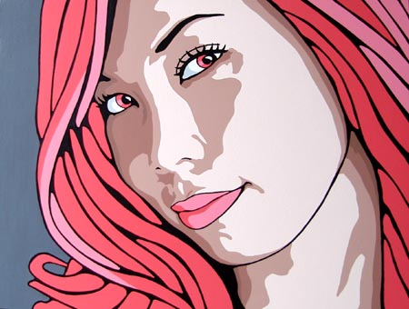
Art Portraits
By William

Slide 2
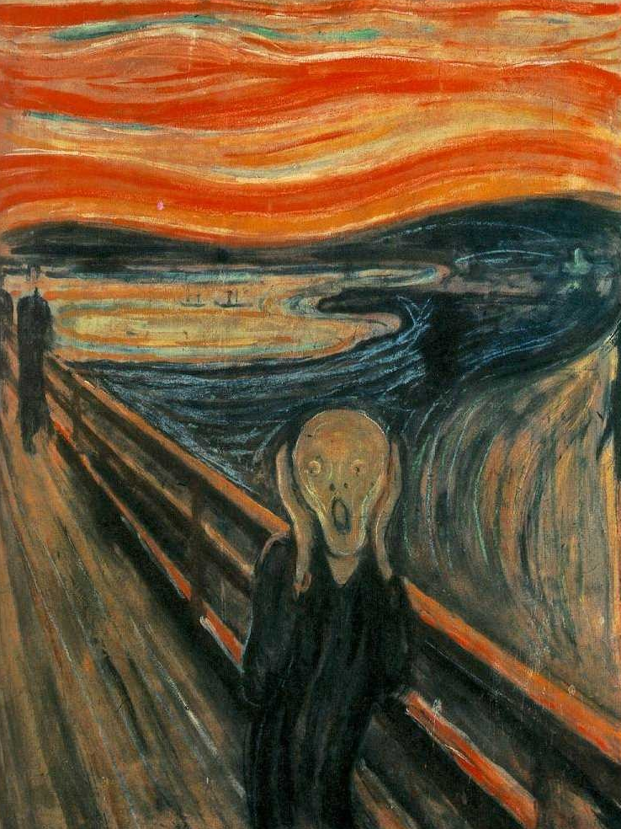
The Scream
Oil, tempera, and pastel on cardboard
91 × 73.5 cm

Slide 3
The Scream
The scream by drawn up by Skrik in 1993. This portrait was made with Oil, tempera, and pastel on cardboard. The portrait expresses feelings and the sadness in his life. The portrait stands at 91 × 73.5 cm.

Slide 4
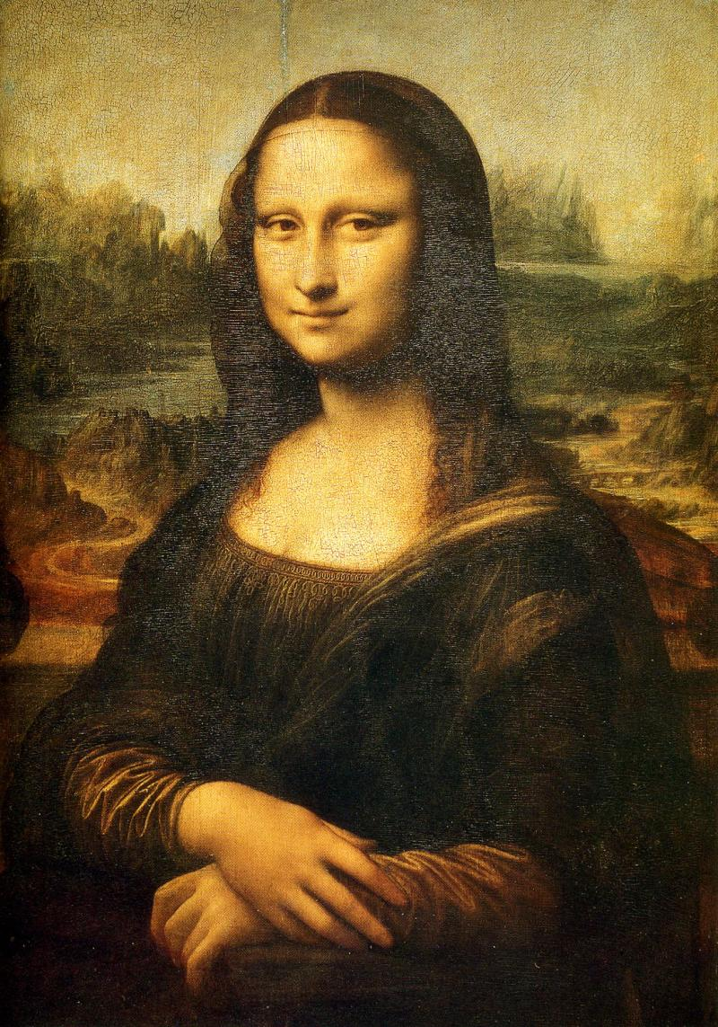
The Mona Lisa

Slide 5
The MONA LISA
This figure of a woman, dressed in the Florentine fashion of her day and seated in a creative, mountainous landscape, is a remarkable instance of Leonardo's technique of soft, heavily shaded modeling. The Mona Lisa's mysterious expression, which seems both alluring and aloof, has given the portrait universal fame. Its stands at 77 x 53 cm and I painted with Oil on Wood.

Slide 6
Websites
http://www.ibiblio.org/wm/paint/auth/vinci/joconde/
http://en.wikipedia.org/wiki/The_Scream

